Slide 1
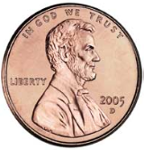

START
END

Slide 2
Depth-First Search
Stack Contents:
V0
V4, V1
V4, V3
V4, V6, V5
V4, V6
V4
Empty
V₀
V₂
V₁
V₄
V₆
V₃
V₅
A traversal processes only those vertices that can be reached from the start vertex.

Slide 3
Breadth-First Search
Queue Contents:
V0
V1, V4
V4, V3
V3
V6, V5
V5
Empty
V₀
V₂
V₁
V₄
V₆
V₃
V₅

Slide 4
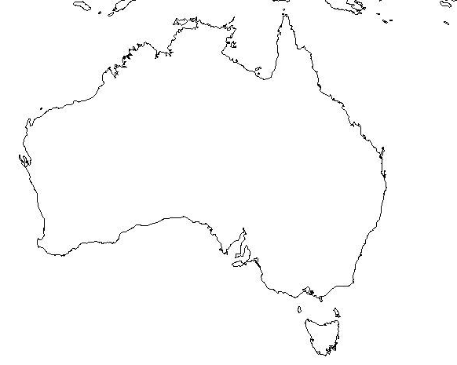
DFS:
  Sydney
  Canberra
  Brisbane
  Adelaide
  Melbourne
  Hobart
  Perth
  Black Stump
  Darwin
BFS:
  Sydney
  Canberra
  Melbourne
  Brisbane
  Adelaide
  Hobart
  Perth
  Black Stump
  Darwin
Darwin
Black Stump
Brisbane
Perth
Adelaide
Canberra
Sydney
Melbourne
Hobart

